Slide 1
Year 11
Information Evening

Slide 2
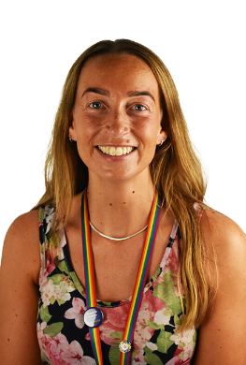
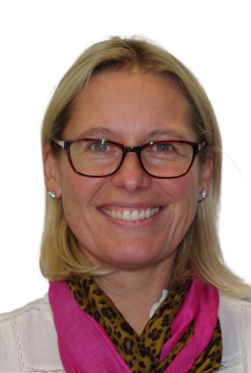
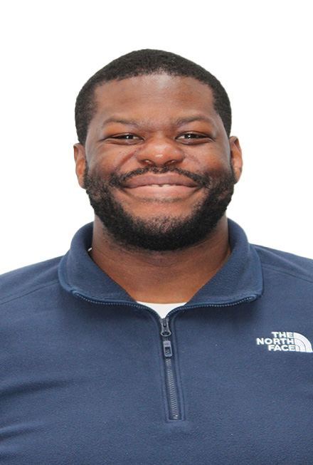
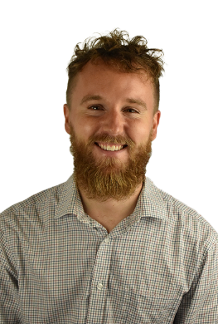
The Key Stage 4 team
Mr Coe – Y11 Pastoral Team Leader
Miss Crew – Y11 Student Support Leader
Mrs Allen – Head of Key Stage 4
Mr Richardson – Raising Attainment Lead/Assistant Principal

Slide 3
Staff support
Pastoral Team
Tutor: day to day support, first point of contact
Student support leader: Miss Crew (mental wellbeing, routines, behaviour)
Pastoral team leader: Mr Coe (academic progress, attendance)
Head of Key stage: Mrs Allen
Teachers
Quality first teaching, assessment & feedback, homework, after school provision
SEN team
LSA support in lessons for those who are entitled, pupil profiles, exam provision
Careers
Careers advisor: Alex Williams
Mentors (Abdi, Dan, Karim)

Slide 4
Year 11 - Key dates and events
Key event | Date
Mock exams | 14th October – 15th November | Mock exam across all studied subjects
Parent reports | 6th December | Mock & predicted grades and attendance
Mock exams | 10th – 28th February | Mock exam across all studied subjects
Coursework drop-down days | W/c 3rd March | Intervention for specific students with their coursework
Parent reports | 17th March | Mock & predicted grades and attendance
Parent Carer evening | 19th March | Meet subject teachers, support with post-16 and wellbeing
Start of GCSE exams | w/c 5th May – w/c 23rd June | Students required to be in school each day throughout all of the exam period.
Notes:
Two contingency dates for exam: Tuesday 11th June PM and all day on the 25th June – only holidays after that!!

Slide 5
After school revision support
Day | Subject | Location
Monday | Religion & Philosophy Business coursework | TF1 TF4
Tuesday | History | AF5
Wednesday (depending on staff meetings) | Art/Photography and Food | B Wing (top floor)
Thursday | Music coursework Drama coursework | Music dept – AG10 TF4
Friday | Maths | TF5

Slide 6
Other key events to look out for…
Leavers hoodies – letters out in January 2025, price approx £16/17
Leavers assembly: This usually takes place just before the final whole cohort exam in June (2nd week of June). Provisional date Weds 11th June.
Prom – Wednesday 25th June at the Grange Hotel, Winterbourne. Price approx £35

Slide 7
How to support your child during the year
Strong attendance to school – if there are concerns, please let us know.
Organisation – punctuality to school & lessons, fully equipped, attends after school clubs, meets deadlines (coursework)
Revision – study space at home, revision timetable, use the techniques learnt in school
Wellbeing – work life balance, healthy diet, sport/social, reach out for support at school (tutor, SSL, Bea), Kooth (https://www.kooth.com/)

Slide 8
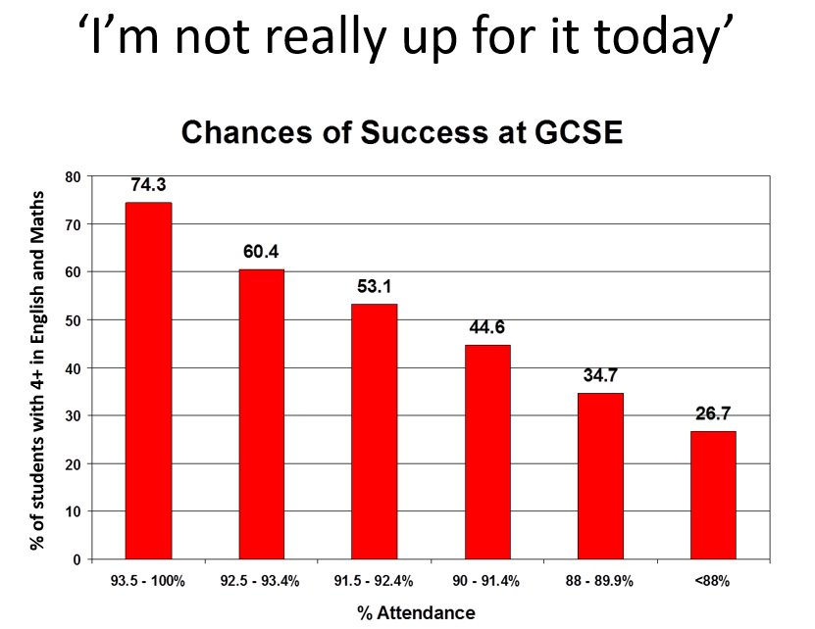
Attendance

Slide 9
Looking after your own wellbeing during stressful times

Slide 10
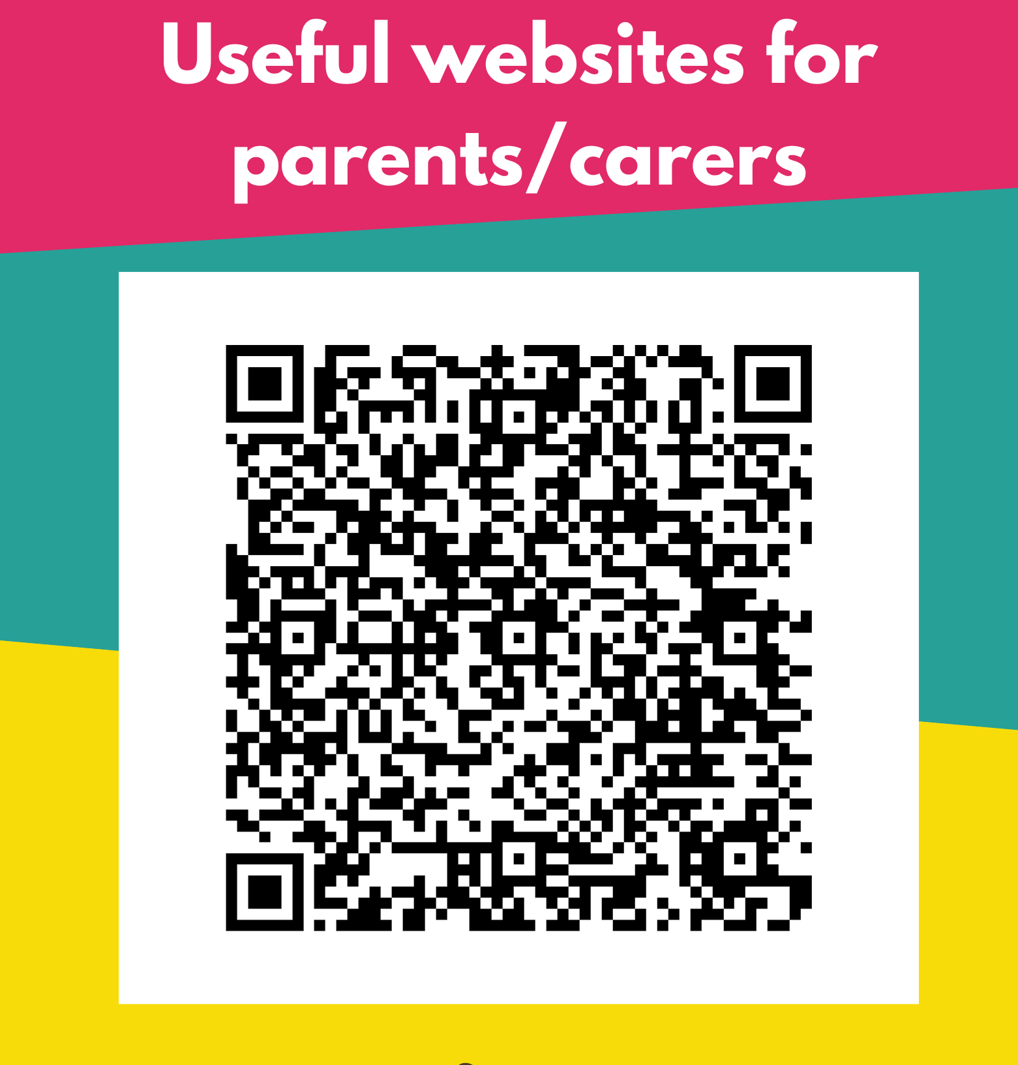
Notes:
I will stay around to answer any questions you might like to ask; please add questions to the chat.

Slide 11
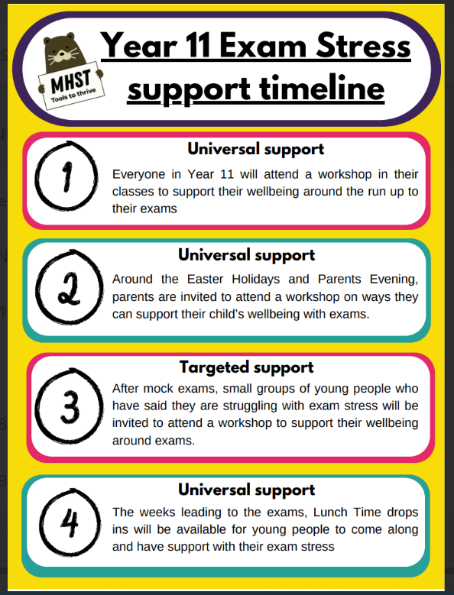

Slide 12
Revision support
Revision/flash cards
Grab a card/piece of paper.
Write a question on one side.
Write the answer on the other.
Quiz yourself with them until the knowledge is embedded, or get a friend/classmate/family member to quiz you.

Slide 13
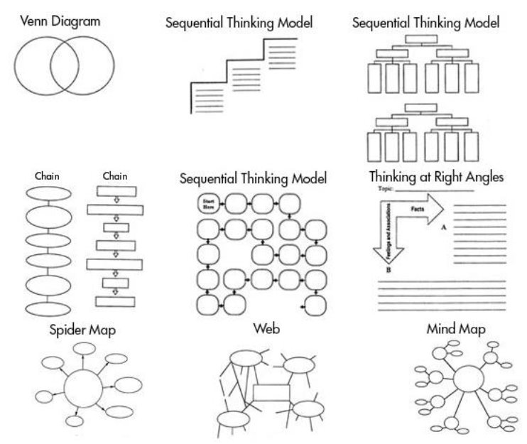
Revision support
2) Graphic Organisers
They are visual thinking tools that help organise information and ideas in a way that is easy to comprehend and internalise.

Slide 14
Revision support
3) Look, Cover, Write, Check
Read up to four chunks of information from your book/work/revision guide...
Cover your book/work/revision guide (NO PEEKING!)
Try to write it down accurately from memory
Check your copying against the book/work/revision guide, correcting errors and fill in gaps
Repeat until you are able to write the information down accurately.

Slide 15
Other ideas?
Past papers/practice exam questions
Revision apps- Quizlet for e.g.
Reading around the subject
Converting content into drawings and symbols

