Slide 1
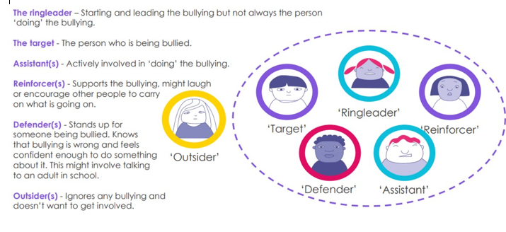
JCA Anti-Bullying Policy – Student Friendly Version
JCA has a moral and legal duty to protect students from bullying behaviours.
JCA does not tolerate discriminatory and bullying behaviours based on race, gender, appearance, sexuality, special educational needs and disability, and / or home circumstances.
JCA adopts the Anti-Bullying Alliance definition of bullying as:
“The repetitive, intentional hurting of one person or group by another person or group, where the relationship involves an imbalance of power. It can happen face to face or online.”
JCA recognises the Anti-bullying Alliance social model of bullying, to include the following roles:
Target, Ring Leader, Reinforcer, Assistant, Defender and the Outsider.
JCA will recognise students taking the roles of Ring leader, Reinforcer and Assistant as perpetrators of the bullying.
JCA will investigate and sanction bullying behaviours that occur face to face, and online, and that occur in school, and on the journey to and from school.
JCA encourages all students and parents to report any behaviours of concern. These can be reported to any member of staff, to reception, or via the JCA contact email address JCAinfo@clf.uk.
All reported incidents will be investigated promptly. If behaviours are found to be discriminatory or bullying, parent meetings will be held and appropriate sanctions, educational activities and restorative actions will be arranged.
Repeat involvement in bullying behaviours will result in escalating sanctions.
A JCA Anti-Bullying Working Group, consisting of interested staff, students and parents, will meet on a termly basis to progress anti-bullying strategies.

